Slide 1
Chapter 3
Organization: Structure and Culture

Slide 2
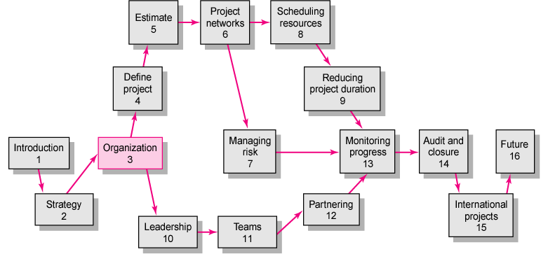

Slide 3

Project Management Structures
Challenges to Organizing Projects
  The uniqueness and short duration of projects relative to ongoing longer-term organizational activities
  The multidisciplinary and cross-functional nature of projects creates authority and responsibility dilemmas.
Choosing an Appropriate Project Management Structure
  The best system balances
  the needs of the project
  with the needs of the
  organization.

Slide 4
Project Management Structures
Organizing Projects: Functional organization
  Different segments of the project are delegated to respective functional units.
  Coordination is maintained through normal management channels.
  Used when the interest of one functional area dominates the project or one functional area has a dominant interest in the project’s success.

Slide 5
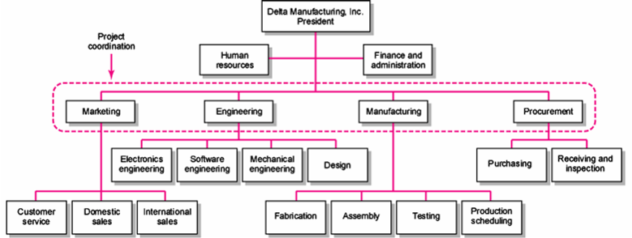
Functional Organizations
FIGURE 3.1

Slide 6
Functional Organization of Projects
Advantages
  No Structural Change
  Flexibility
  In-Depth Expertise
  Easy Post-Project Transition
Disadvantages
  Lack of Focus
  Poor Integration
  Slow
  Lack of Ownership

Slide 7
Project Management Structures (cont’d)
Organizing Projects: Dedicated Teams
  Teams operate as separate units under the leadership of a full-time project manager.
  In a projectized organization where projects are the dominant form of business, functional departments are responsible for providing support for its teams.

Slide 8
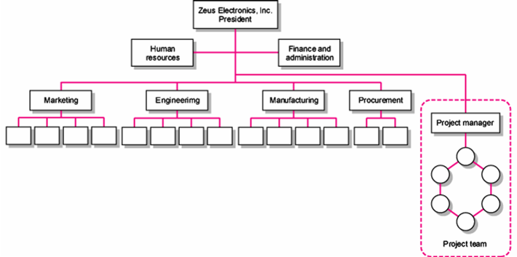
Dedicated Project Team
FIGURE 3.2

Slide 9
Project Organization: Dedicated Team
Advantages
  Simple
  Fast
  Cohesive
  Cross-Functional Integration
Disadvantages
  Expensive
  Internal Strife
  Limited Technological Expertise
  Difficult Post-Project Transition

Slide 10
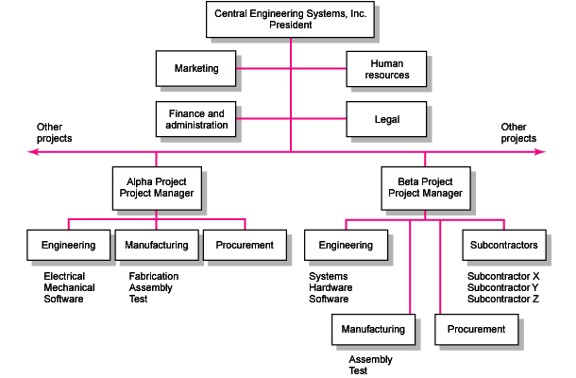
Project Organizational Structure
FIGURE 3.3

Slide 11
Project Management Structures (cont’d)
Organizing Projects: Matrix Structure
  Hybrid organizational structure (matrix) is overlaid on the normal functional structure.
    Two chains of command (functional and project)
    Project participants report simultaneously to both functional and project managers.
  Matrix structure optimizes the use of resources.
    Allows for participation on multiple projects while performing normal functional duties.
    Achieves a greater integration of expertise and project requirements.

Slide 12
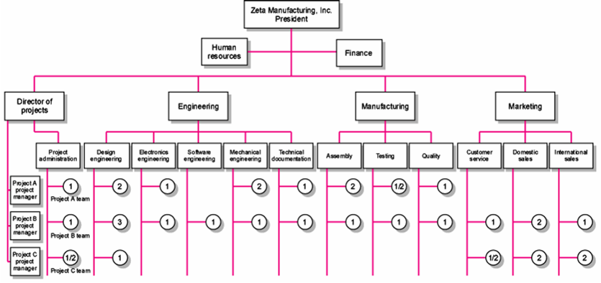
Matrix Organization Structure
FIGURE 3.4

Slide 13
Division of Project Manager and Functional Manager Responsibilities in a Matrix Structure
Project Manager Negotiated Issues Functional Manager
What has to be done? Who will do the task? How will it be done?
When should the task be done? Where will the task be done?
How much money is available to Why will the task be done? How will the project involvement
do the task? impact normal functional activities?
How well has the total project Is the task satisfactorily How well has the functional
been done? completed? input been integrated?
TABLE 3.1

Slide 14
Different Matrix Forms
Functional (also Weak or Lightweight) Form
  Matrices in which the authority of the functional manager predominates and the project manager has indirect authority.
Balance (or Middleweight) Form
  The traditional matrix form in which the project manager sets the overall plan and the functional manager determines how work to be done.
Strong (Heavyweight) Form
  Resembles a project team in which the project manager has broader control and functional departments act as subcontractors to the project.

Slide 15
Project Organization: Matrix Form
Advantages
  Efficient
  Strong Project Focus
  Easier Post-Project Transition
  Flexible
Disadvantages
  Dysfunctional Conflict
  Infighting
  Stressful
  Slow

Slide 16

Project Management Structures (cont’d)
Organizing Projects: Network Organizations
  An alliance of several organizations for the purpose of creating products or services.
    A “hub” or “core” firm with strong core competencies outsources key activities to a collaborative cluster of satellite organizations.

Slide 17
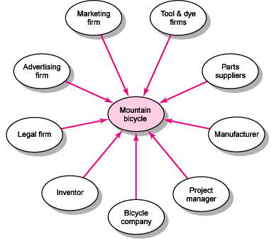
Mountain Bicycle Network Project
FIGURE 3.5

Slide 18
Project Organization: Network Form
Advantages
  Cost Reduction
  High Level of Expertise
  Flexible
Disadvantages
  Coordination of Breakdowns
  Loss of Control
  Conflict

Slide 19
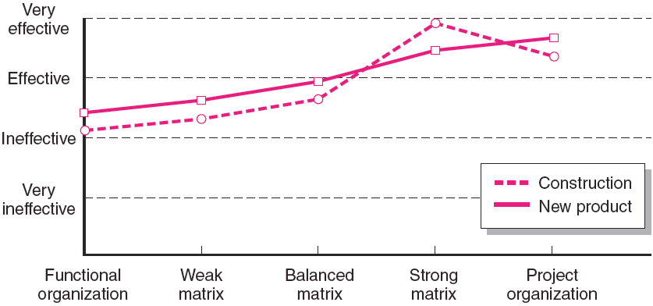
Rated Effectiveness of Different Project Structures by Type of Project
Source: Larson, E. W., and Gobeli, D. H., “Matrix Management: Contradictions and Insights,” California Management Review, vol. 29, no. 4 (Summer 1987), p. 137.
FIGURE 3.6

Slide 20

Choosing the Appropriate Project Management Structure
Organization (Form) Considerations
  How important is the project to the firm’s success?
  What percentage of core work involves projects?
  What level of resources (human and physical) are available?

Slide 21
Choosing the Appropriate Project Management Structure (cont’d)
Project Considerations
  Size of project
  Strategic importance
  Novelty and need for innovation
  Need for integration (number of departments involved)
  Environmental complexity (number of external interfaces)
  Budget and time constraints
  Stability of resource requirements

Slide 22
Organizational Culture
Organizational Culture Defined
  A system of shared norms, beliefs, values, and assumptions which bind people together, thereby creating shared meanings.
  The “personality” of the organization that sets it apart from other organizations.
    Provides a sense of identify to its members.
    Helps legitimize the management system of the organization.
    Clarifies and reinforces standards of behavior.

Slide 23
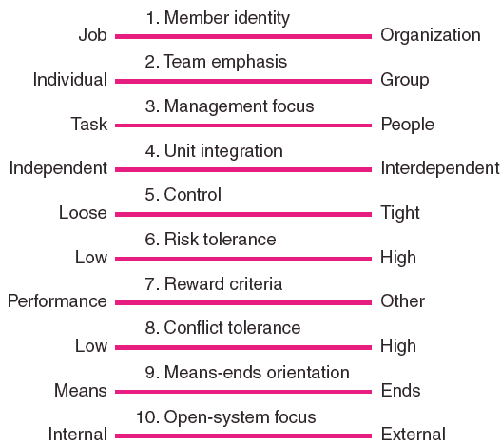
Key Dimensions Defining an Organization’s Culture
FIGURE 3.7

Slide 24
Identifying Cultural Characteristics
Study the physical characteristics of an organization.
Read about the organization.
Observe how people interact within the organization.
Interpret stories and folklore surrounding the organization.

Slide 25
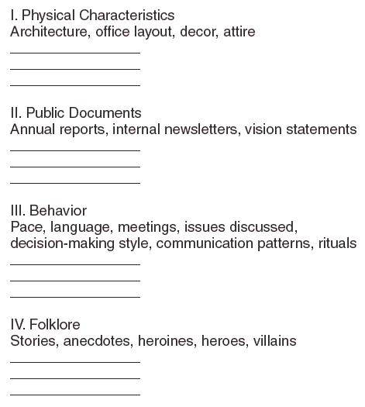
Organizational Culture Diagnosis Worksheet
FIGURE 3.8

Slide 26

Implications of Organizational Culture
for Organizing Projects
Challenges for Project Managers in Navigating Organizational Cultures
  Interacting with the culture and subcultures of the parent organization
  Interacting with the project’s clients or customer organizations
  Interacting with other organizations
  connected to the project

Slide 27
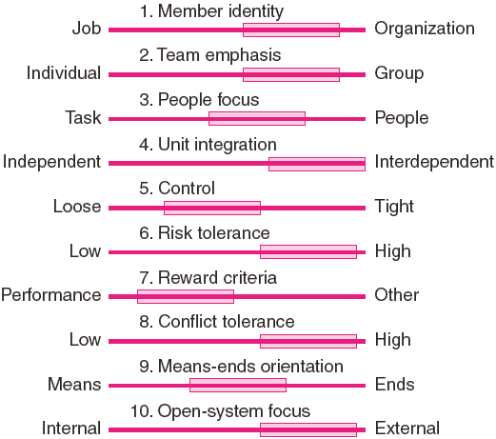
Cultural Dimensions of an Organization Supportive
of Project Management
FIGURE 3.9

Slide 28
Key Terms
Balanced matrix
Dedicated project team
Strong matrix
Matrix
Organizational culture
Weak matrix
Projectitis
Projectized organization
Network organization

Slide 29
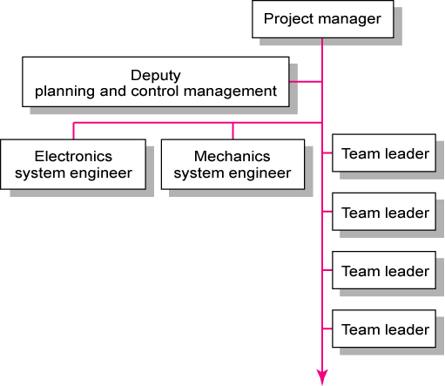
Organization of Product Development Projects at ORION
FIGURE C3.1

Slide 30
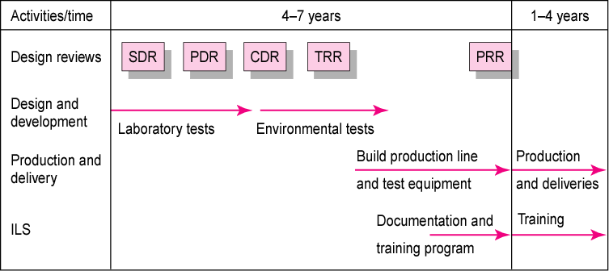
Traditional Master Plan at ORION
FIGURE C3.2

Slide 31
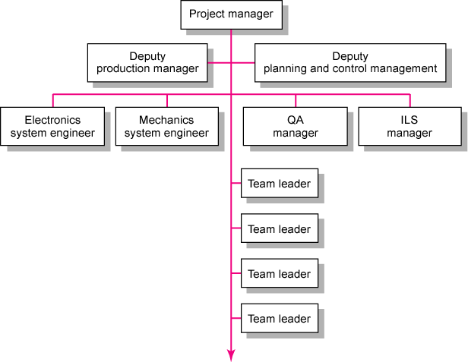
Proposed Project Organization for the Jaguar Project
FIGURE C3.3

Slide 32
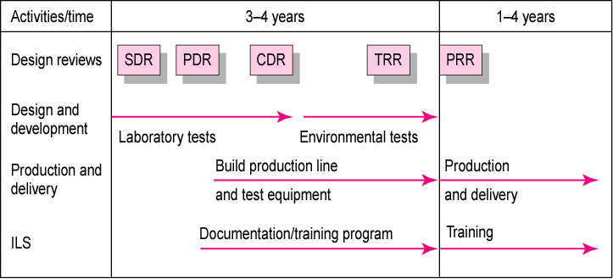
Jaguar Master Plan
FIGURE C3.4

Slide 33
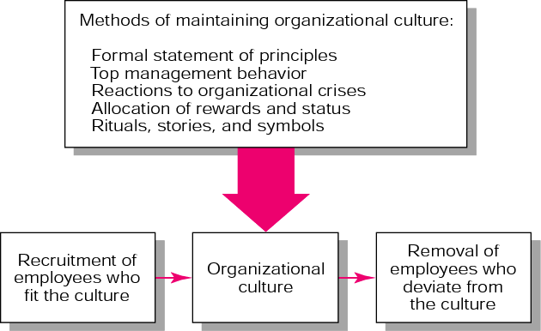
Mechanisms for Sustaining Organizational Culture
FIGURE A3.1

